Slide 1

Prak-justBuyUnique
Mentor: Presented by :
Mr. Sharad Gupta Aastha Gupta(191500004)
Ayush Singh(191500202)
Kashish Varshney(191500387)
Priyansh Srivastava(191500607)
Rachit Gupta(191500614)

Slide 2
Outline
About the Project
Objective
Technology Used Requirements
Snapshots from the Project

Slide 3
About the Project
The project “Prak-justBuyUnique” is an online shopping website which is used for various products where customers will be able to buy online products.
It is a Small Start-Up where people will come together to buy and sell unique items and will surely take advantage of it.
It is an Indian Based E-commerce website which is a go-to Trending B2B site for millions of makers of Handmade goods, vintage items and craft products.

Slide 4
Objective
It is a Small Start-Up where people will come together to buy and sell unique items.
Best handmade items for customers.
Instructs you how to order in bulks.
It gives you multiple sales like seasonal, festive,etc.

Slide 5
Technology Used
HTML: HTML The first publicly available description of HTML was a document called "HTML Tags" , first mentioned on the Internet by Tim Berners-Lee in late 1991.
CSS: Cascading Style Sheets (CSS) is a style sheet language used for describing the presentation of a document written in a markup language such as HTML.
JavaScript: It is a high-level programming language that follows the ECMAScript standard. It was originally designed as a scripting language for websites but became widely adopted as a general-purpose programming language.

Slide 6
.
Bootstrap: It is a free and open-source CSS framework directed at responsive, mobile-first front-end web development. It contains CSS- and (optionally) JavaScript-based design templates for typography, forms, buttons, navigation, and other interface components.
PHP: Hypertext Preprocessor is a scripting language that helps people make web pages more interactive by allowing them to do more intelligent, complex things. PHP code is run on the web server.website with no programming cannot do this without other complex things.

Slide 7
Requirements
Hardware Requirements
Hard Disk : 100 MB upto 500 MB
RAM : 1 GB
Processor : 1.6 GHz or faster processor
Software Requirements
Operating System : Windows,MAC OS
User Interface:HTML,CSS,BOOTSTRAP
Database : MariaDB
Programming Language : PHP
Application Software : Visual Studio Code (version 1.61.0)
Web Browser : Google Chrome, Mozilla Firefox

Slide 8
THIS IS HOW OUR WEBSITE LOOKS
Hope you will like it...

Slide 9
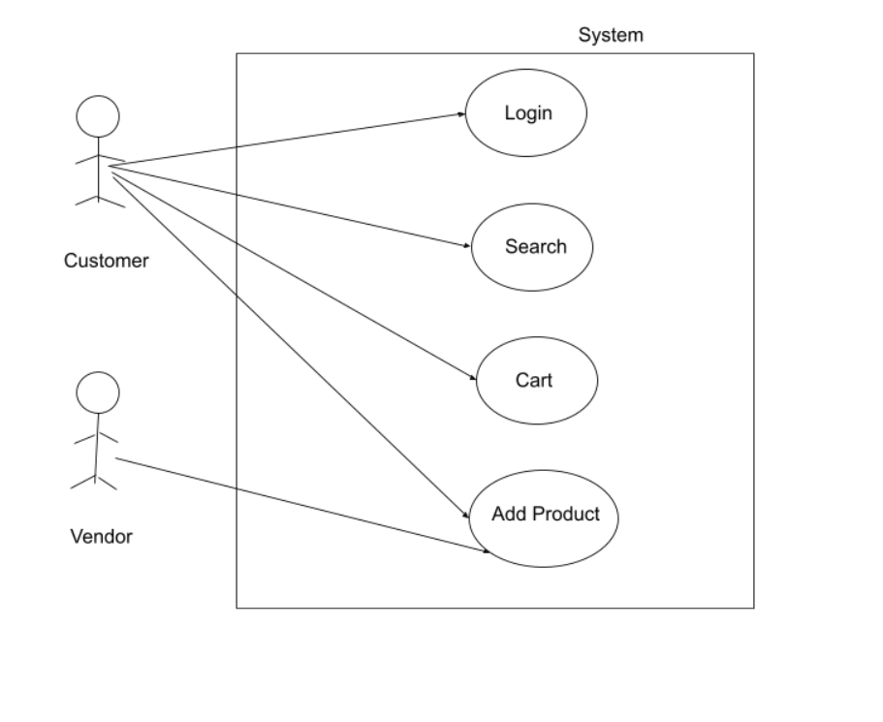
Flow Chart for User

Slide 10
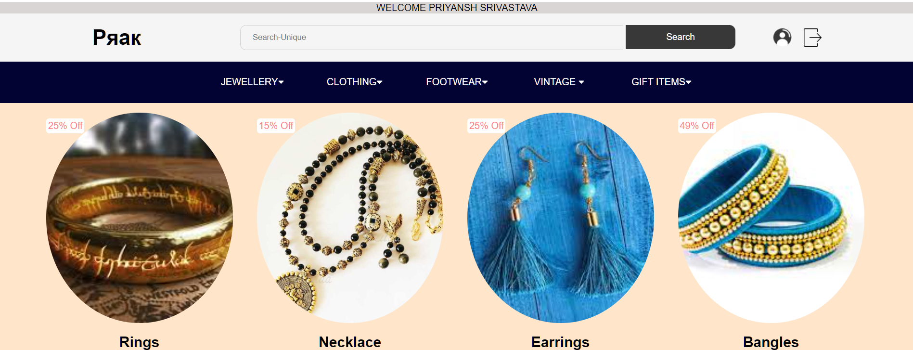
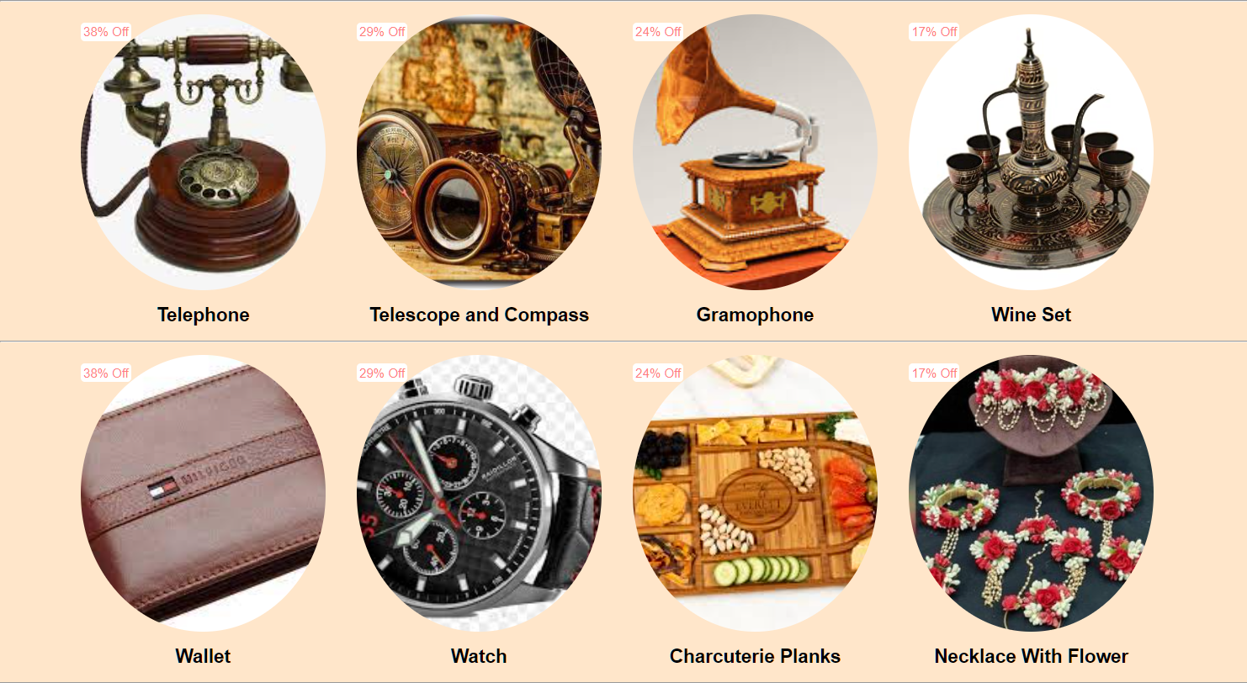
User Interface
Splash Screen-
Splash Screen: The first screen with which the user interacts will be this screen containing the logo and our first page .

Slide 11
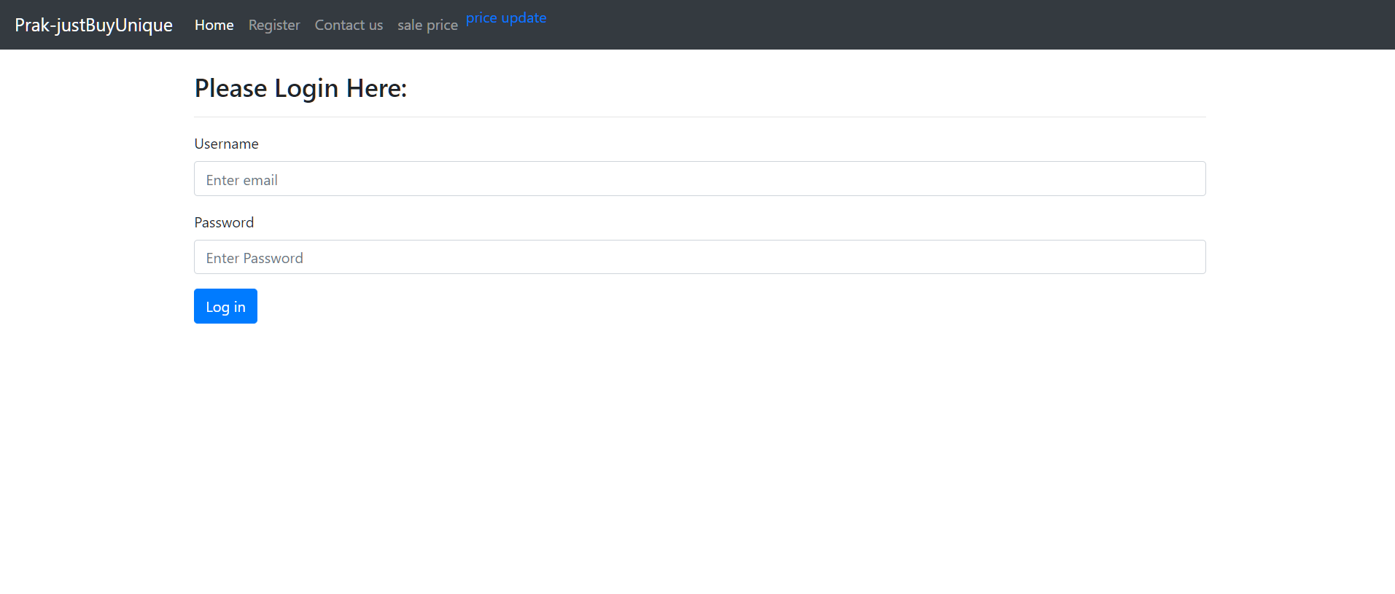
Login Page-
This page is for those users who have already registered themselves on the website and have a username and a password. There is also a way on this page for the new users to register themselves which will take them to the registration page.

Slide 12
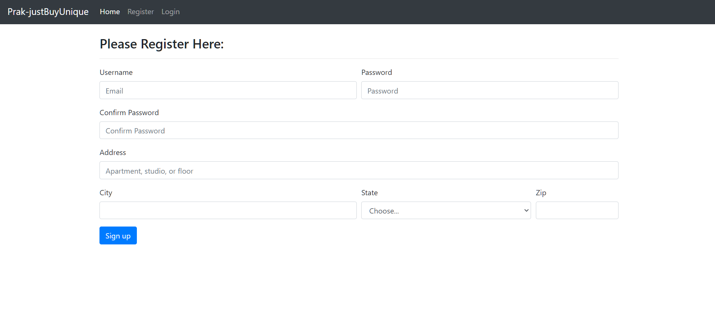
Register Page-
This is page is solely designed for the new
users of the app who are willing to register themselves. This page takes input of the various details of the user and stores it in the database, later helping the user to login into the account with credentials they have provided.

Slide 13
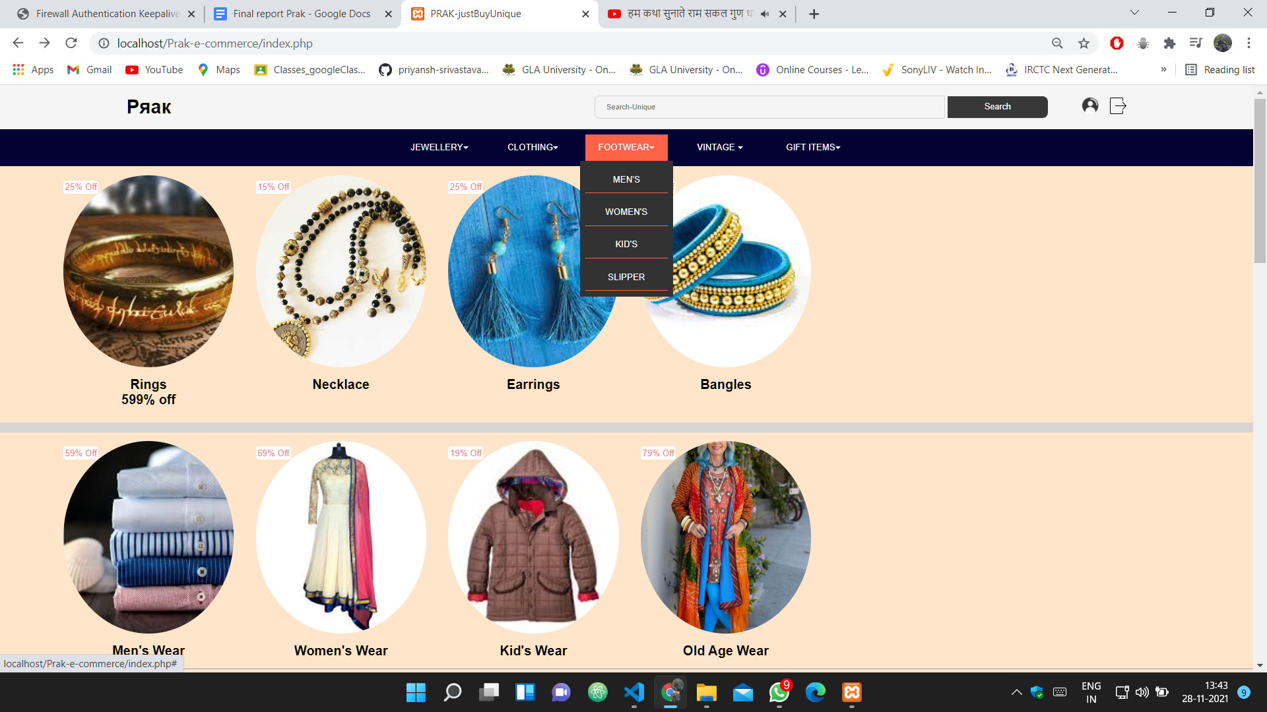
Navigation Panel-
This is the most important part of the application that provides interactivity within the website as it connects the various activities together like it takes directly to items.

Slide 14
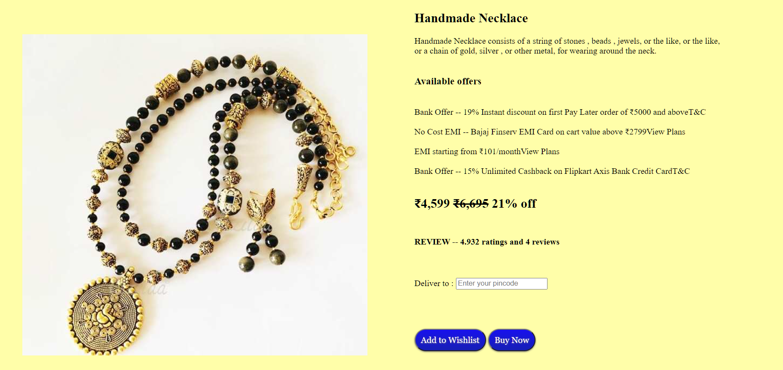
Item Description-
Handmade items (like jewellery, bags, clothes, etc. ) which has been assembled and formed by hand rather than through the use of machines.

Slide 15
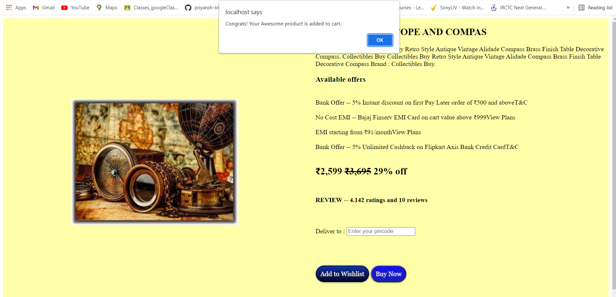
Product Added to wishlist-
Number of times
the product was added to
the shopping cart
(Enhanced Ecommerce).

Slide 16
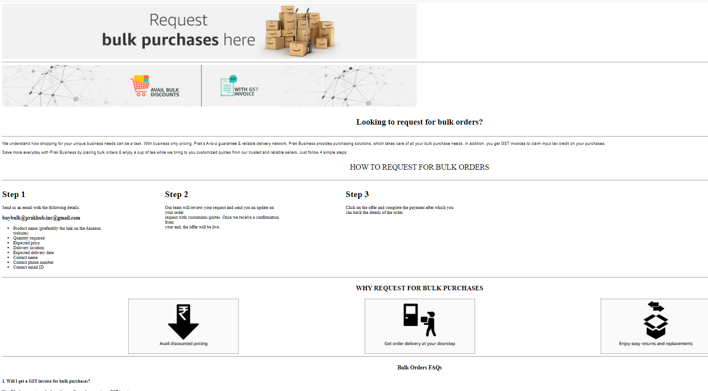
Steps How To Order-
Step1- Find the items you would like
to purchase.
Step2- Add items to your favourites.
Step3- If you are a registered customer, please sign in. If you are not, you can sign up by clicking on “CREATE AN ACCOUNT”.
Step4- Enter your shipping details by filling in all fields marked with an "*".
Step5- Please select your preferred shipping method.Select your payment method
Step6- Check your mailbox - you should receive an order confirmation email.

Slide 17

Project
The source of our project (including all the project work, documentations and presentations) will be available at the following link -
https://github.com/rachit2308/Prak-justBuyUnique.git

Slide 18
THANK YOU

